Slide 1
Serialization Framework
Giaohangtietkiem.vn – 06/2018
R&D team

Slide 2
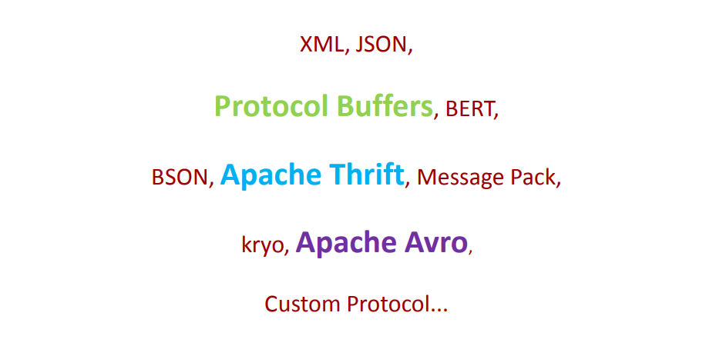
Serialization Framework

Slide 3
Common Properties in Serialization Frameworks
Interface Description Language (IDL)
Performance
Versioning
Binary Format

Slide 4

Google Protobuff
Designed ~2001 because everything else wasn’t that good those days
Production, proprietary in Google from 2001-2008, open-sourced since 2008
Battle tested, very stable, well trusted
Every time you hit a Google page, you're hitting several services and several PB code
PB is the glue to all Google services
Official support for five languages: C++, Java, Python, and Go
Does have a lot of third-party support for other languages (of highly variable quality)
Current Version - protobuf-3.5.1
BSD License

Slide 5

Apache THRIFT
Designed by an X-Googler in 2007
Developed internally at Facebook
Thrift was open sourced in April 2007 and entered the Apache Incubator in May, 2008. Thrift became an Apache TLP in October, 2010.
Aims to be the next-generation PB (e.g. more comprehensive features, more languages)
IDL syntax is slightly cleaner than PB. If you know one, then you know the other
Supports: C++, Java, Python, PHP, Ruby, Erlang, Perl, Haskell, C#, Cocoa, JavaScript, Node.js, Smalltalk, OCaml and Delphi and other languages
Offers a stack for RPC calls
Current Version - Apache Thrift v0.11.0
Apache License 2.0

Slide 6
Typical Operation Model
The typical model of Thrift/Protobuf use is
Write down a bunch of struct-like message formats in an IDL-like language.
Run a tool to generate Java/C++/whatever boilerplate code.
Example: thrift --gen java MyProject.thrift
Outputs thousands of lines - but they remain fairly readable in most languages
Link against this boilerplate when you build your application.
DO NOT EDIT!

Slide 7
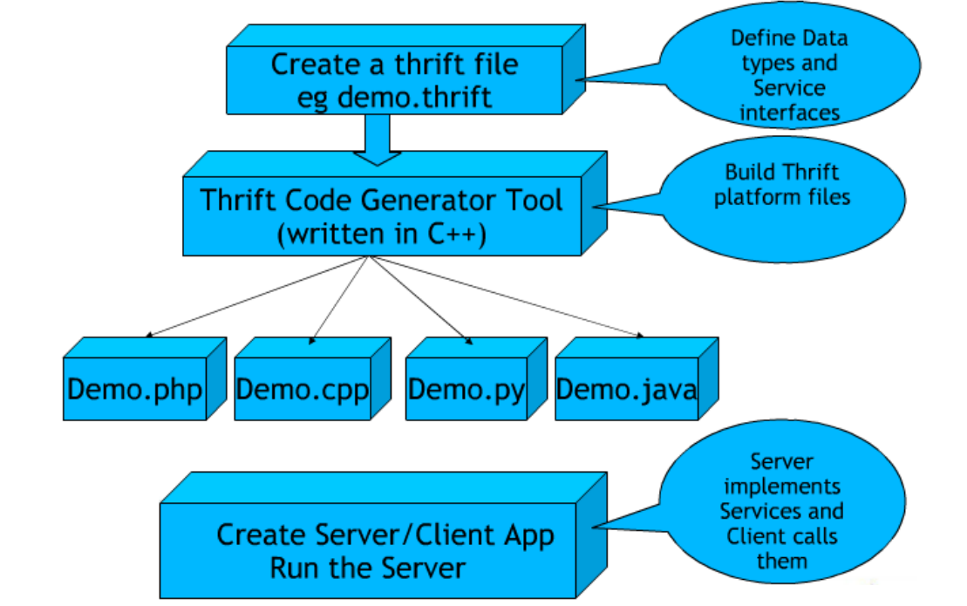
Typical Operation Model

Slide 8
Interface Definition Language (IDL)
IDL is a specification language used to describe a software component's interface.
IDLs describe an interface in a language-independent way, enabling communication between software components that do not share a language – for example, between components written in C++ and components written in Java.

Slide 9
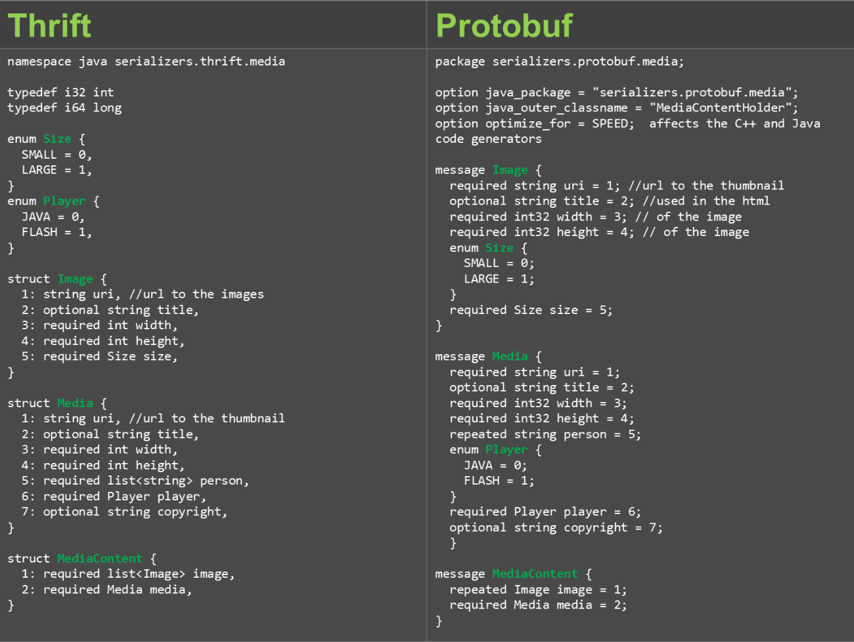

Slide 10
Defining IDL Rules
Every field must have a unique, positive integer identifier ("= 1"," = 2" or " 1:", " 2:" )
Fields may be marked as ’required’ or ’optional’
structs/messages may contain other structs/messages
You may specify an optional "default" value for a field
Multiple structs/messages can be defined and referred to within the same .thrift/.proto file

Slide 11
Tagging
The numbers are there for a reason!
• The "= 1", " = 2" or " 1:", " 2:" markers on each element identify
the unique "tag" that field uses in the binary encoding.
• It is important that these tags do not change on either side
• Tags with values in the range 1 through 15 take one byte to
encode
• Tags in the range 16 through 2047 take two bytes
• Reserve the tags 1 through 15 for very frequently occurring
message elements

Slide 12
Example
• example2.proto
message Ex1 {
required int32 num = 1; // field tag
}
• Code snippet:
obj= example2_pb2.Ex1();
obj.num = 290; // field value
obj.SerializeToString();
• Output :
08 A2 02 #hex
000010001010001000000010 #binary

Slide 13
Example
 | Wire type |  |  | Field tag |  |  |  | Field value
0 | 0 | 0 | 0 | 1 | 0 | 0 | 0 | 1 | 0 | 1 | 0 | 0 | 0 | 1 | 0 | 0 | 0 | 0 | 0 | 0 | 0 | 1 | 0

Slide 14
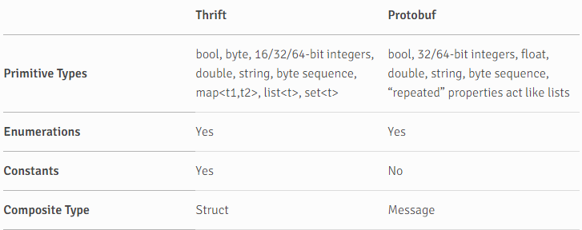
The Comparison

Slide 15
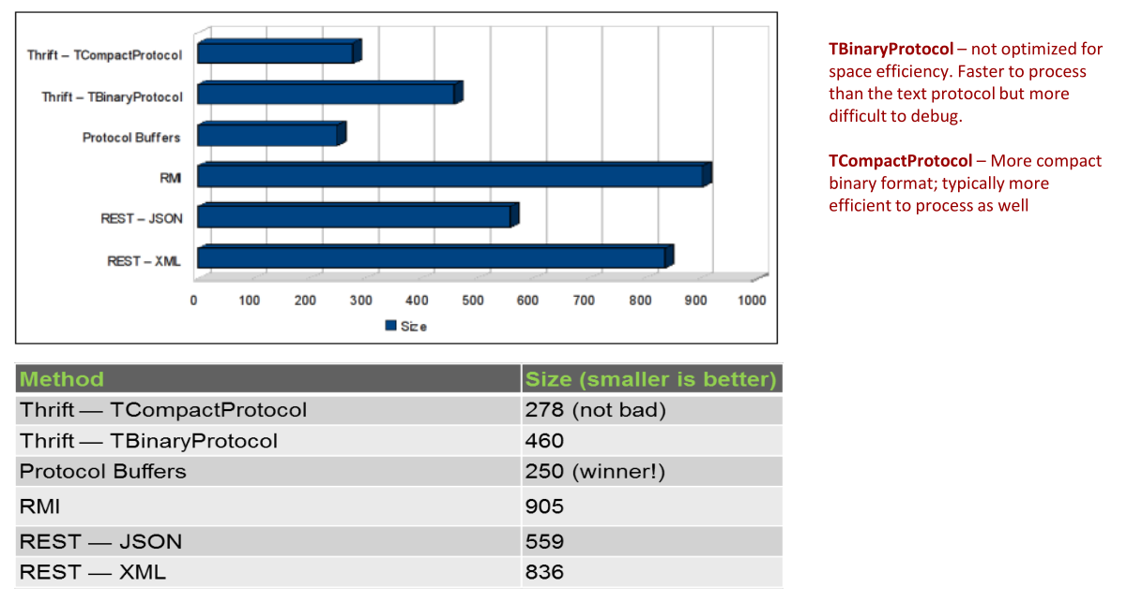
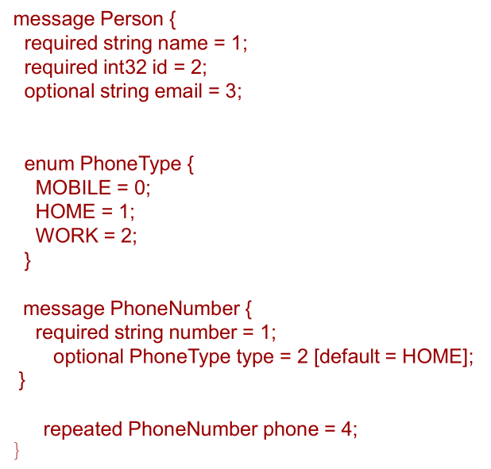
The Comparison

Slide 16
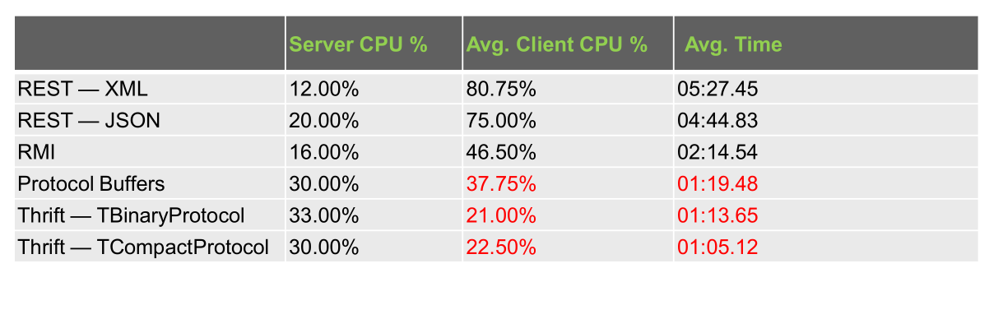
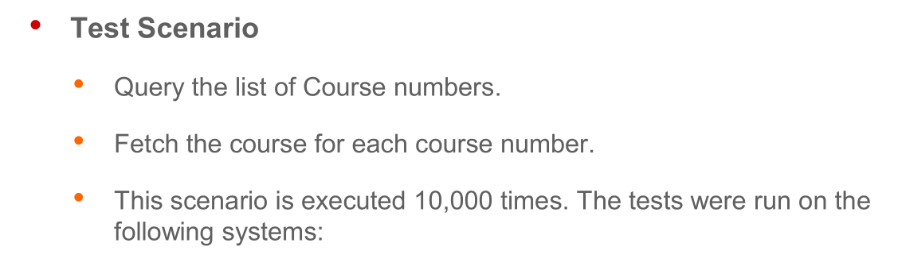
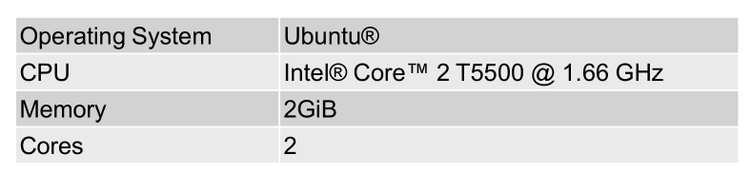
The Comparison

Slide 17
Project
Thrift | Protobuf
• Facebook • Cassandra project • Hadoop supports access to its HDFS API through Thrift bindings • HBase leverages Thrift for a cross-language API • Hypertable leverages Thrift for a cross-language API since v0.9.1.0a • LastFM • DoAT • ThriftDB • Scribe • Evernote uses Thrift for its public API. • Junkdepot | • Google • ActiveMQ uses the protobuf for Message store • Netty (protobuf-rpc)

Slide 18
Choice
Thrift | Protobuf
• Your language requirements are anything but Java, C++ or Python. See above. • You need additional data structures like Map and Set • You want a full client/server RPC implementation built-in • You're a Rock Star programmer that doesn't need documentation or examples | • You're only using Java, C++ or Python. Experimental support for other languages is being developed by third parties but are generally not considered ready for production use • You already have an RPC implementation • On-the-wire data size is crucial • The lack of any real documentation is scary to you

Slide 19
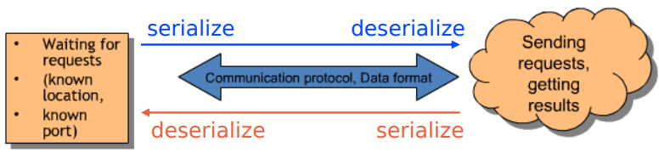
Basic question are:
What kind of protocol to use, and what data to transmit?
Efficient mechanism for storing and exchanging data
What to do with requests on server side?

Slide 20
Properties
Expressive: Complex, nested data structures
Efficient: Fast, small, compact
Dynamic: Program can process & defines new data types
Remote procedure call
API
Schemas evolution
Versioning

Slide 21
Avro - Introduction
A data serialization created by Doug Cutting
Includes
A schema language
A compact serialized form
An RPC framework
A handful of APIS, is a handful of languages
Goal
Cross-language
Support for dynamic access
Simple but expressive schema evolution

Slide 22
Avro - Schema
JSON: {“type”: “typeName” …attributes”}
Primitive types: null, Boolean, int, long, float, double, bytes, string
Complex types:
Records
Enums
Arrays
Maps
Unions
Fixed

Slide 23
Avro – Protocol declaration
{
"namespace": “vn.ghtk.randd",
"protocol": "HelloWorld",
"doc": "Protocol Greetings",
"types": [
{
"name": "Greeting",
"type": "record",
"fields": [{"name":"message","type":"string"}]
},
{
"name": "Curse",
"type": "error",
"fields": [{"name":"message","type":"string"}]
}
],
"messages": {
"hello": {
"doc": "Say hello.",
"request": [{"name":"greeting","type":"Greeting"}],
"response": "Greeting",
"errors": ["Curse"]
}
}
}
Describe RPC interfaces using json

Slide 24
Avro - Handshake
To ensure client and server have each other’s protocol definition
All requests/responses are prefixed by handshakes
RPC requests and responses may not be processed until a handshake has been completed
Use record schema: HandshakeRequest vs HandshakeResponse

Slide 25
Avro - Resolution
Reader’s schema may has schema not be exactly the schema that was expected (Writer’s schema)
-> Records may be have had fields added or removed
If schema not match -> Error
To match (not exactly) -> rules; have some promotable
int -> long -> float -> double
string -> bytes -> string

Slide 26
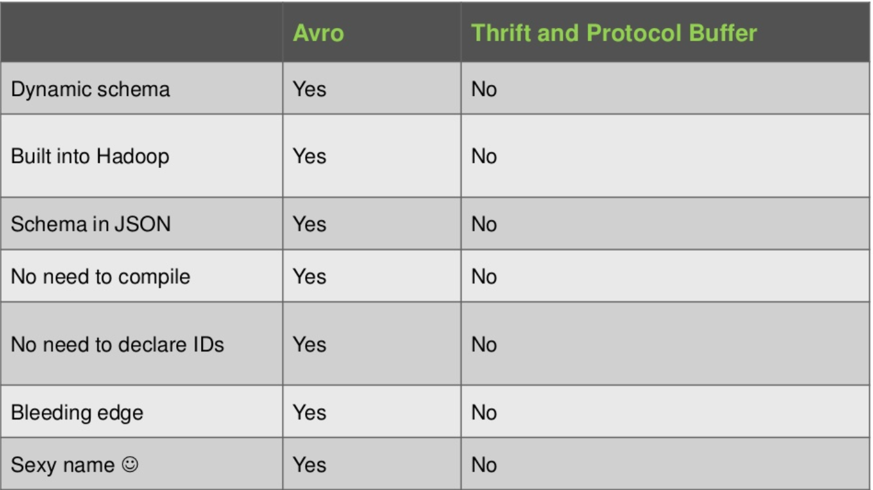
Avro vs Thrift, Protocol Buffer

Slide 27
Serialization Framework
Which one is the better of the lot?

Slide 28
Row-oriented, Column-oriented systems
RowId | EmpId | Lastname | Firstname | Salary
001 | 10 | Smith | Joe | 40000
002 | 12 | Jones | Mary | 50000
003 | 11 | Johnson | Cathy | 44000
004 | 22 | Jones | Bob | 55000
Storage hardware requires the data to be serialized
Hard disk are organized into a series of blocks (several rows)
Most expensive operations involving hard disk are seeks

Slide 29
Row-oriented system
RowId | EmpId | Lastname | Firstname | Salary
001 | 10 | Smith | Joe | 40000
002 | 12 | Jones | Mary | 50000
003 | 11 | Johnson | Cathy | 44000
004 | 22 | Jones | Bob | 55000
001:10,Smith,Joe,40000;
002:12,Jones,Mary,50000;
003:11,Johnson,Cathy,44000;
004:22,Jones,Bob,55000;
Optimized and particularly good for OLTP (On-Line Transaction Process) workloads
Find all record with salaries between 40k and 50k/ Sum all salaries -> full scan (without index)
Indexes ->overhead when change data

Slide 30
Column-oriented system
RowId | EmpId | Lastname | Firstname | Salary
001 | 10 | Smith | Joe | 40000
002 | 12 | Jones | Mary | 50000
003 | 11 | Johnson | Cathy | 44000
004 | 22 | Jones | Bob | 55000
10:001,12:002,11:003,22:004;
Smith:001,Jones:002,Johnson:003,Jones:004;
Joe:001,Mary:002,Cathy:003,Bob:004;
40000:001,50000:002,44000:003,55000:004;
Serializes all of the values of a column together
Well-suited for OLAP (On-Line Analytic Process)
Limits the IO to only the data that is needed
Save space: Columnar layout compress better

Slide 31
Parquet - Introduction
Column-oriented binary file format
Schema segregated into footer
Uses the record shredding and assembly algorithm described in the Dremel paper
Each data file contains the values for a set of rows
High level of integration with Hadoop Ecosystem (Hive, Impala, Spark)
Allows compress: Snappy, Gzip

Slide 32
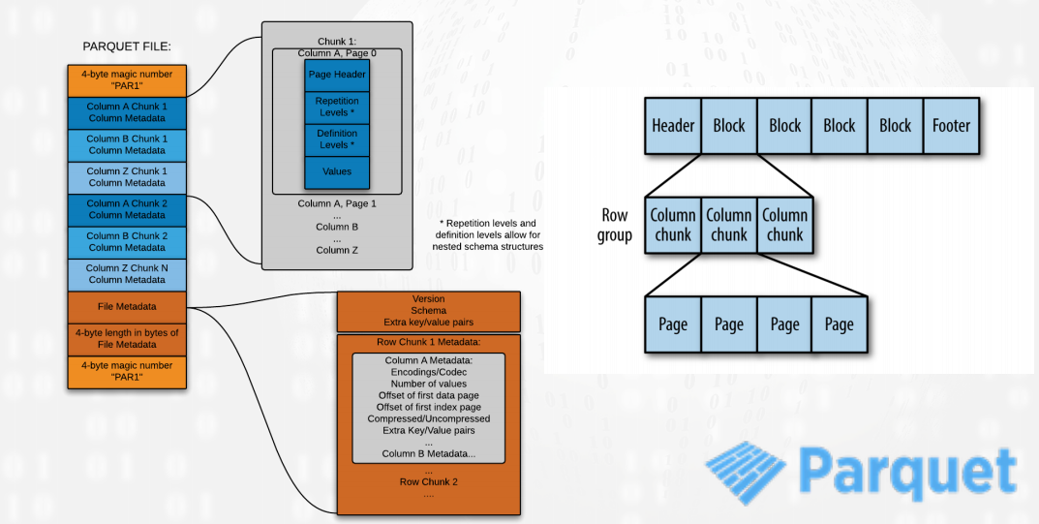
Parquet- File format

Slide 33
Parquet – Few important notes
Requires a lot of memory when writing files because it buffers writes to optimize the encoding and compressing of the data
Using nested data structure with Parquet will likely limit some of the optimizations that Parquet makes for pushdowns. Try flatten your schema

Slide 34
How to choice?
Parquet need some additional parsing to format data with increases the overall read time
Avro: works well from system to system, handles schema evolution
Queries: few group of columns -> Use columnar format (Parquet)
Scan or retrieves all the fields in a row in each query -> Avro
Only work on subset of columns -> Parquet

Slide 35
End
Questions and Answers
Thanks

Slide 36
References
http://avro.apache.org/docs/current/spec.html
https://parquet.apache.org/documentation/latest/
https://ganges.usc.edu/pgroupW/images/a/a9/Serializarion_Framework.pdf
https://www.slideshare.net/airisdata/parquet-and-avro?qid=a52ca404-4d2e-4d60-a634-5a8eb858d114&v=&b=&from_search=1
https://www.slideshare.net/HadoopSummit/file-format-benchmark-avro-json-orc-parquet
https://www.slideshare.net/mikejf12/an-introduction-to-apache-avro
https://developers.google.com/protocol-buffers/?hl=vi
https://thrift.apache.org/
https://www.slideshare.net/IgorAnishchenko/pb-vs-thrift-vs-avro

